Slide 1


The K Framework
A tool kit for language semantics and verification
AM Session
Introduction to K
Jin Xing Lim
21st International Symposium on Automated Technology for Verification and Analysis (ATVA 2023) 24 October 2023

Slide 2
Before we start …
Make sure you install K (as it may take quite a while to install):
$ bash <(curl https://kframework.org/install)
$ kup install k
Notes:
Soon to be replaced by Proof of Stake

Slide 3




Who are we?
Runtime Verification Inc. is a software quality assurance company aimed at using formal methods to perform security audits on virtual machines and smart contracts on public blockchains.
It is dedicated to improving the safety, reliability, and correctness of software systems in the blockchain field (and other fields, too!)

Slide 4


Look for us!
Jin Xing Lim
@0xJinXingLim
(AM session)
Palina Tolmach
@palinatolmach
(PM session)

Slide 5
Overview
AM Session: Introduction to K
PM Session: Smart Contract Verification with KEVM
Github repository for all materials
https://github.com/runtimeverification/k-tutorial-atva-2023

Slide 6
AM Session Overview
What is K?
K Hands-on
K’s Logical Foundation: Matching Logic

Slide 7
What is K?

Slide 8

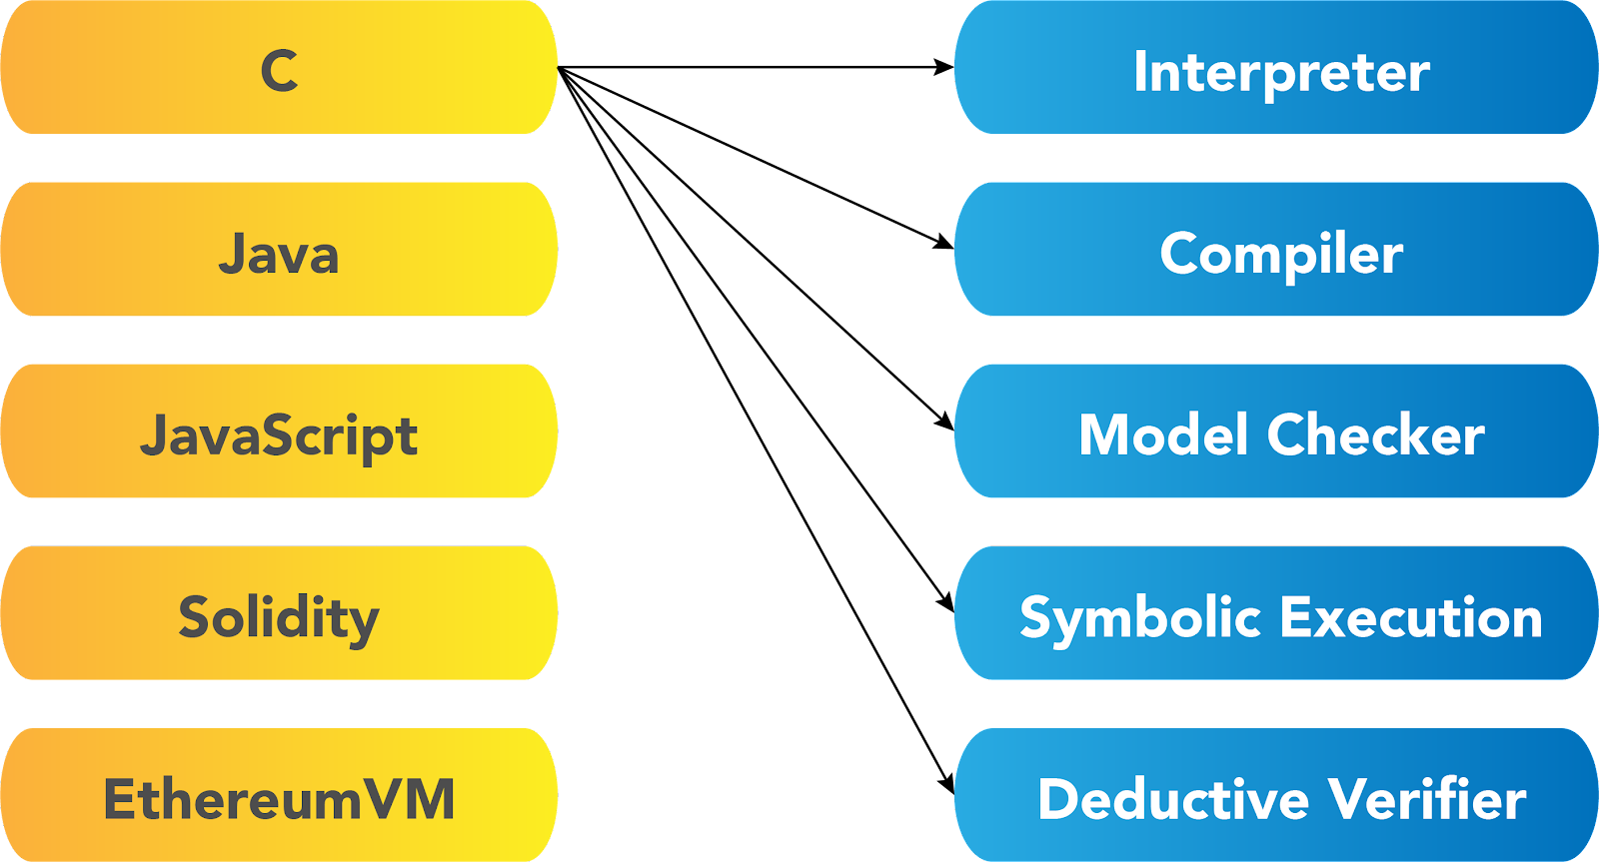
The Problem: Too Many Tools
‹#›

Slide 9
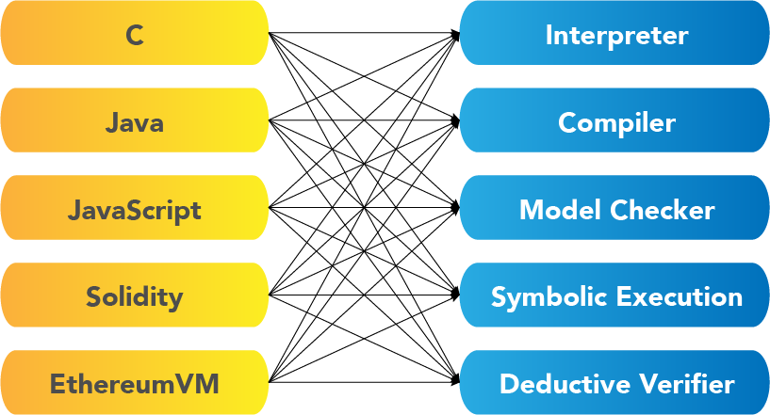
The Problem: Too Many Tools
‹#›

Slide 10
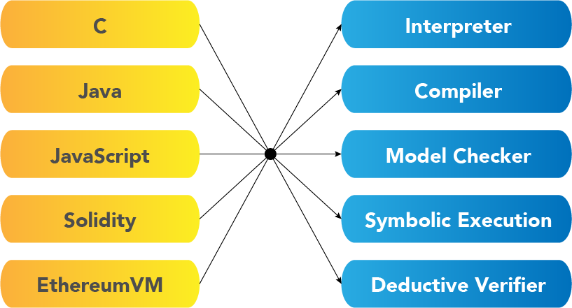

The K Approach
Develop each language and each tool once:
Updates to tools benefit all the languages

Slide 11
What is K?
K is an operational semantics framework based on rewriting.
Specify your language or system as a K definition.
The K compiler derives a number of tools (parser, printer, interpreter, prover)
Project started almost 20 years ago, building on earlier rewriting systems
K’s logical foundation is Matching Logic
Many-sorted first-order formalism
Given a K specification, there are two main backends you can use:
LLVM backend is for concrete execution, you get a fast interpreter out of it.
Haskell backend is for symbolic execution, you get a reachability verification engine and model checker out of it.
Webpage: https://kframework.org

Slide 12

Applications
K implementations of:
C
Java
Python
Rust
Boogie
Ethereum VM (PM Session)
WebAssembly
…and more
Where to find them?
github.com/runtimeverification
github.com/kframework

Slide 13
K Hands-on

Slide 14
Step-by-step tutorial
Github repository for all materials
https://github.com/runtimeverification/k-tutorial-atva-2023

Slide 15
Other K materials
K Github repository
Do the K tutorial!
Build programming languages in K!
K User Manual
K research problems

Slide 16
K’s Logical Foundation: Matching µ-Logic

Slide 17
Matching µ-Logic - Signature
Definition (Matching μ-Logic Signature):
A matching μ-logic signature is a tuple (S, Var, Σ) where:
S is a non-empty set of sorts
Var = EVar ∪ SVar is a disjoint union of two countably infinite S-indexed sets of sorted variables
Σ is a (S* × S)-indexed set of countably many many-sorted symbols, such that Σ = {Σ_{s1, …, sn, s} }_{s1...sn,s∈S}
Notations:
x : s, where x ∈ EVar_{s} and s ∈ S means "x is an element variable of sort s"
X : s, where X ∈ SVar_{s} and s ∈ S means "X is a set variable of sort s"

Slide 18
Matching µ-Logic - Signature
Examples from calc.k
Definition (Matching μ-Logic Signature):
A matching μ-logic signature is a tuple (S, Var, Σ) where:
S is a non-empty set of sorts (e.g., S = {Int})
Var = EVar ∪ SVar is a disjoint union of two countably infinite S-indexed sets of sorted variables (e.g., I1, I2 in rule I1 + I1 => I1 +Int I2)
Σ is a (S* × S)-indexed set of countably many many-sorted symbols, such that Σ = {Σ_{s1, …, sn, s} }_{s1...sn,s∈S} (e.g., Σ = {+_{Int x Int → Int} , -_{Int x Int → Int} , … })
Notations:
x : s, where x ∈ EVar_{s} and s ∈ S means "x is an element variable of sort s"
X : s, where X ∈ SVar_{s} and s ∈ S means "X is a set variable of sort s"

Slide 19
Matching µ-Logic - Pattern
Definition (Matching μ-Logic Pattern):
A matching μ-logic pattern for a signature (S, Var, Σ), is defined inductively as follows:
φ_{s} ::= x : s ∈ EVar_{s}
| X : s ∈ SVar_{s}
| φ_{s} ⋀ φ_{s}’
| ㄱφ_{s}
| ∃x : s’.φ_{s}
| σ(φ_{s1, …,}φ_{sn}) if symbol σ ∈ Σ_{s1, …, sn, s}
| μX : s.φ_{s} if φ_{s} is positive in X : s (least fixpoint*)
* least solution, under set containment, of the equation X : s “=” φ_{s} of set variable X : s (intuitively, it means finding the solution from bottom up)

Slide 20
Matching µ-Logic - Pattern
More pattern notations
Notations:
φ₁ ∨ φ₂ ≡ ¬(¬φ₁ ∧ φ₂)
φ₁ → φ₂ ≡ ¬φ₁ ∨ φ₂
φ₁ ↔ φ₂ ≡ (φ₁ → φ₂) ∧ (φ₂ → φ₁)
∀x : s.φ ≡ ¬∃x : s.¬φ
⊤_{s} ≡ ∃x : s.x (#Top)
⊥_{s} ≡ ¬⊤_{s} (#Bottom)
νX : s.φ_{s} ≡ ¬μX : s.¬φ_{s}[¬X/X] (greatest fixpoint)
* greatest solution, under set containment, of the equation X : s “=” φ_{s} of set variable X : s (intuitively, it means finding the solution from top down)

Slide 21
Matching µ-Logic - Definedness
Definition (Definedness):
For any signature (S, Var, Σ) we can add a unary symbol ⌈_⌉_{s}^{s’} ∈ Σ_{s,s’} called definedness. We can also add the definedness axiom, ⌈x : s⌉_{s}^{s’}.
Intuitively, you can think of definedness symbol as the ceiling function, which means in the semantics, ⌈φ⌉_{s}^{s’} will be evaluate to #Top if pattern φ matches at least 1 element, i.e., a set that is non-empty.

Slide 22
Matching µ-Logic - Definedness
Remark:
Definedness allows us to syntactically construct "predicates" from general ML patterns. That is, the above symbol applications will evaluate to either ⊤ or ⊥.
In the Haskell backend, we depend on these properties and make a strong distinction between "terms" and "predicates" for optimisation purposes.

Slide 23
Matching µ-Logic - Definedness
New predicates created due to definedness
Notations:
⌊φ⌋_{s}^{s’} ≡ ¬⌈¬φ⌉_{s}^{s’} (totality) Think of ⌊_⌋_{s}^{s’} as the floor function, i.e., dual of definedness, where the pattern φ has matched everything
x : s ∈_{s}^{s’} φ ≡ ⌈x ∧ φ⌉_{s}^{s’} (membership)
φ₁ =_{s}^{s’} φ₂ ≡ ⌊φ₁ ↔ φ₂⌋_{s}^{s’} (equality)
φ₁ ⊆_{s}^{s’} φ₂ ≡ ⌊φ₁ → φ₂⌋_{s}^{s’} (set containment)

Slide 24
Matching µ-Logic - Reachability
Notions of reachability
Definition (One-path next):
A matching μ-logic signature (S, Var, Σ) can be extended with an additional sort, topConfig, and a unary symbol • ∈ Σ_{topConfig,topConfig}, called one-path next.
Recall: We are doing proofs and rewriting in these <configuration> … <configuration>. This <configuration> … <configuration> is of sort topConfig.
Notation: ◦ φ ≡ ¬ • ¬ φ (all-path next)
Intuition:
• φ is matched by configurations that have at least one next configuration that matches φ.
◦ φ is matched by configurations for which all next configurations match φ.

Slide 25
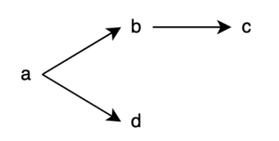
Matching µ-Logic - Reachability
One/All-path next example
The following is a transition system which can be formalised in matching μ-logic. Note that a, b, c, d are constructors (i.e., configurations that are distinct from each other and only matches itself).
Question:
What is the result of • b?
How about the result of ◦ b?

Slide 26
Matching µ-Logic - Reachability
One/All-path next example (solution)
The following is a transition system which can be formalised in matching μ-logic. Note that a, b, c, d are constructors (i.e., all distinct from each other and only matches itself).
Question:
What is the result of • b?
How about the result of ◦ b?
• b = a
◦ b = c ∨ d

Slide 27
Matching µ-Logic - Reachability
All-path reachability
Definition (All-path reachability):
We define the all-path reachability modality, weak always finally as:
< w > φ ≡ νX.(φ ∨ (◦ X ∧ • ⊤))
Intuition:
Either φ holds immediately (greatest fixpoint - νX.φ)
Or νX.(◦ X ∧ • ⊤) ensures that we actually make steps on all paths to reach the destination.

Slide 28
Matching µ-Logic - Reachability
Encoding of reachability
Definition (Rewrite Rule):
A rewrite rule is an implication of the form:
∀x₁, x₂, … .φ(x₁, x₂, …) → •∃y₁, y₂, … .ψ(x₁, ..., y₁, ...)
Definition (All-Path Reachability Claim):
An all-path reachability claim is an implication of the form:
∀x₁, x₂, … .φ(x₁, x₂, ...) →< w > ∃y₁, y₂, … .ψ(x₁, ..., y₁, ...)

Slide 29
control-flow.k as MµL Theory
Sorts: S = { KResult, Int, Bool, Id, Exp, IExp, BExp, Stmt, Block, … }
Variables: Var = EVar ∪ SVar is a disjoint union of two countably infinite S-indexed sets of sorted variables
Symbols: Σ = { ^_{IExp x IExp→IExp}, …, <=_{BExp x BExp→BExp}, …, if_{BExp x Block x Block →Stmt}, … }
Example of rewrite rule (rule <k> I1 + I2 => I1 +Int I2 ... </k>):
∀I1, I2.φ(+(I1, I2)) → • ψ(+Int(I1, I2))
Example of claim (last one with while loop in control-flow-spec.k):
leftTerm ∧ requires →< w > rightPattern
where leftTerm includes the while loop in <k> cell, S:Int, N:Int in the <mem> cell and requires is >=Int(N, 0)

Slide 30
More on Program as MµL Theory
Try to map procedures.k as a MµL theory
For more advanced developers, you should look at the definition of the theory, and compare it to the definition.kore file generated by the K frontend, in the ...-kompiled directory, which the Haskell backend consumes. They are more or less the same.

Slide 31
More on Matching Logic
Find out more at
http://www.matching-logic.org/

Slide 32





Questions?
https://runtimeverification.com/
@rv_inc
https://discord.com/invite/CurfmXNtbN
contact@runtimeverification.com

